Slide 1
The purpose of this project is to predict loan , will customer have payment difficulties for their loans ?
MACHINE-LEARNING
By:
Arwa
Njood
Yara

Slide 2


First, dataset overview
This data set was taken from kaggel.
This data set have
307,511 Rows
18 Columns
The data set have null values in occupation type, cnt fam members, amt good price

Slide 3
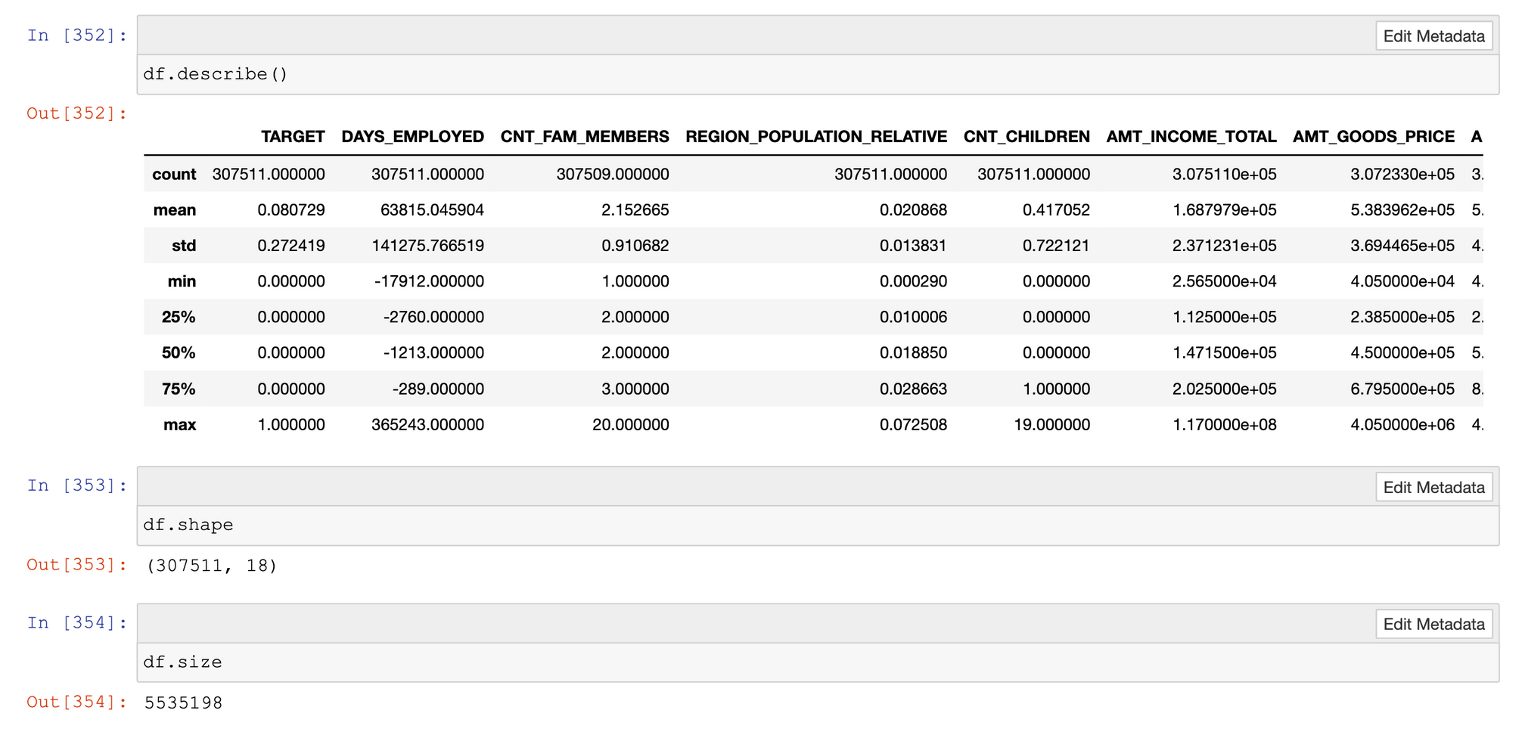
First, dataset overview
size of data set
Shape of data set

Slide 4
First, dataset overview
describe data set

Slide 5
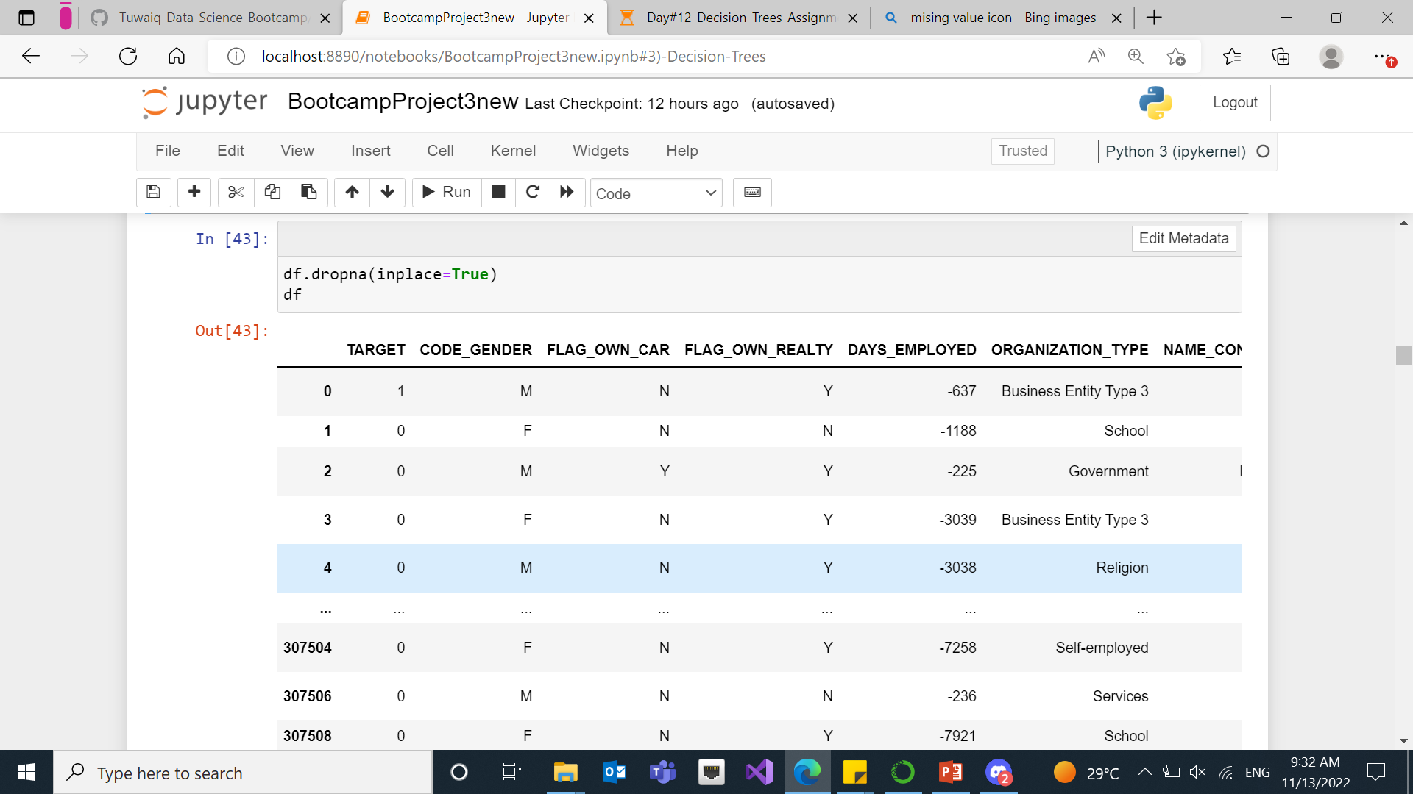
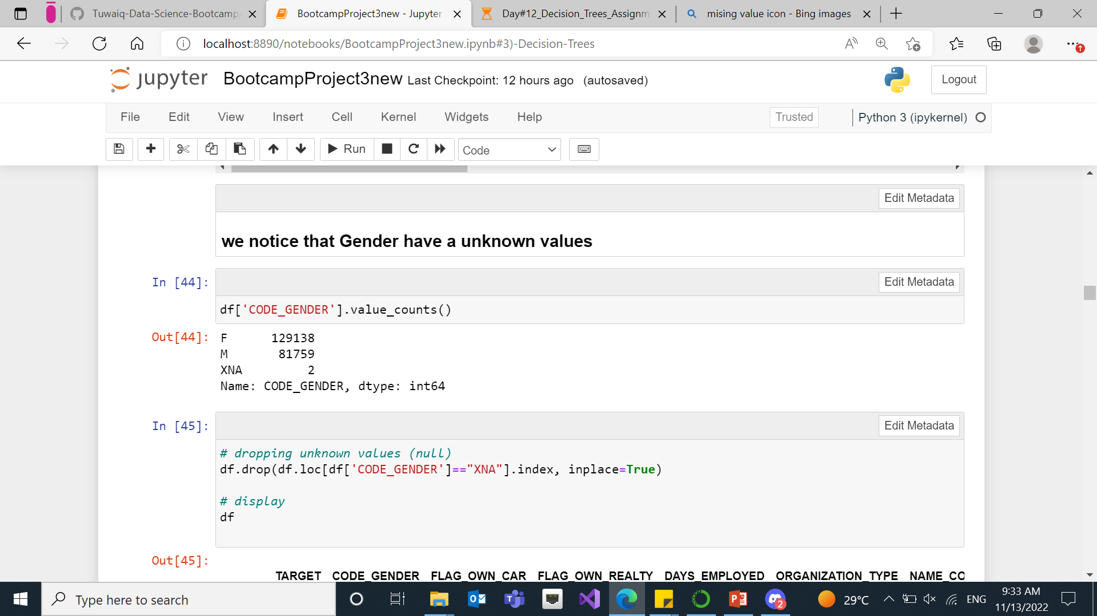
Second, pre processing
Dropping all null values
Dropping unknown values

Slide 6
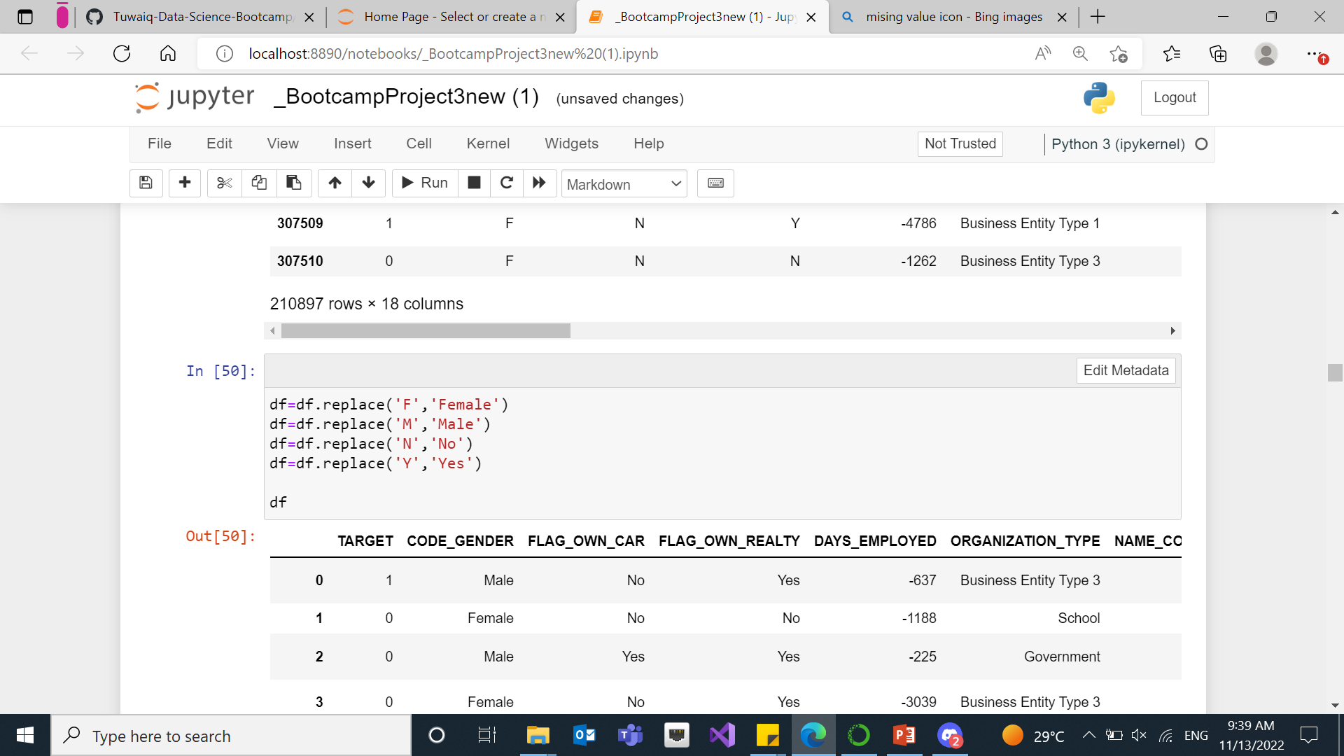
Second, pre processing
Data cleansing

Slide 7
Python code

Slide 8
Comparing models
We notice that Logistic Model Random Forest maybe is the best model for our project, then Random Forest. Based on Confusion Matrix and Accuracy score .
Model | Accuracy | Confusion Matrix
Logistic Model | 0.91 | [[57764, 0], [ 5506 ,0]]
Decision Tree | 0.82 | [[51636 ,6152], [ 4690, 792]]
Random Forest | 0.91 | [[57744 ,20], [ 5499 ,7]]

Slide 9
Thank you
We look forward your ideas and thoughts of how can we improve the models

